Slide 1
Mid-I Presentation
By Team—2
WAGMARE SANJANA | 22QM1A6760
RANGDAL PAVANSAI | 22QM1A6748
U. SAI HRUTHVIN | 21N81A67C5
BOLLAPALLY MANISH KUMAR | 22QM1A6606
BOBBILI RUCHILASYA | 23QM5A6601

Slide 2

Selected Problem Statement
The current UPSC preparation platforms, including the apps Super Kalam and CSEWhy, do not focus on the critical issues that a candidate from a rural or underrepresented region is likely to face. These apps provide generic content, limited language support, and poor performance tracking, which is far from providing personalized learning paths and interactive features that are crucial for effective preparation.
In addition, financial barriers, language constraints, and poor digital accessibility further this divide between urban and rural aspirants, thereby restricting opportunities for the diverse participation of aspirants in civil services.
There is a deep need for a cost-effective, inclusive, and technologically advanced solution that capitalizes on AI-driven personalization, multilingual support, and advanced performance analytics to deliver quality education that is accessible. By filling these gaps, the effort will not only democratize UPSC preparation but also help to reduce educational inequalities and empower future leaders to lead sustainable development in India.

Slide 3
Insights from User interaction
- Surveyed UPSC aspirants from urban and rural regions.
- Identified key issues:
Language barriers (Limited study materials in regional languages).
Lack of personalized learning paths (Generic study materials).
High costs of coaching centers (Financial accessibility issues).
Poor performance tracking (Limited analytics in current platforms).
- Users expressed interest in an AI-driven platform with:
Customized study plans.
Mock test-based progress tracking.
AI-powered topic summarization.
Multi-language support (Telugu, Hindi, English, etc.).

Slide 4
Analysis of End-User
User Type | Challenges Faced | Needs
Rural Aspirants | Language barrier, internet connectivity, lack of access to quality coaching | Offline mode, regional language support
Working Professionals | Time constraints, difficulty in finding structured content | Personalized study plans, quick revision summaries
First-Time Aspirants | No prior guidance, unaware of exam strategy | Structured learning path, mentoring
Repeat Aspirants | Need better mock test analysis, improvement tracking | AI-driven analytics, error-specific recommendations

Slide 5
Milestones with Timeline
Week 4: Conducted survey form. (Form Link)(Response Link)
Week 5: Searching for free API’ (Frontend & Backend). Week 6: Searching Databases & User Authentication System
Week 7: Syllabus Tracker & Mains Test Series Implementation
Week 8: AI Mentorship & Discussion Forum Enhancement
Week 9: Performance Tracking & Revision Planning.

Slide 6
Gap Analysis
User Requirements | Limitations of Existing Technology/Method | Image /Diagram of existing method
Super Kalam | Limited language support, generic content | Multi-language AI-powered content
CSEWhy | Weak performance tracking | AI-driven personalized progress reports
Offline Coaching | Expensive, location-dependent | Affordable, digital-first learning

Slide 7
Criteria:
Criteria | Design Metric | Unit
Content Quality | Accuracy & relevance of materials | 40%
User Engagement | Active users & retention | 30%
Mock Test Effectiveness | Improvement in aspirants' scores | 20%
AI Efficiency | Topic summarization accuracy | 10%

Slide 8
Constraints
Constraint | Design Metric | Unit
Limited Internet Access | Offline Mode & Lightweight Data Consumption | Yes/No
Language Barriers | Multilingual Support | Number of Languages
Financial Constraints | Free/Paid Model & Affordable Pricing | INR/User
Device Compatibility | Cross-Platform Support (Web & Mobile) | Yes/No
Data Security | Secure Authentication & Encryption | AES-256, OAuth

Slide 9
Proposed Solution
Sarthana – The Ultimate UPSC Preparation Hub
AI-powered personalized learning platform.
Multilingual support – Study in Telugu, Hindi, English, etc.
AI-driven topic summarization for quick revision.
Mock tests & real-time analytics for performance tracking.
Daily current affairs dashboard for latest updates.
Essay-writing & evaluation tool for UPSC Mains.

Slide 10
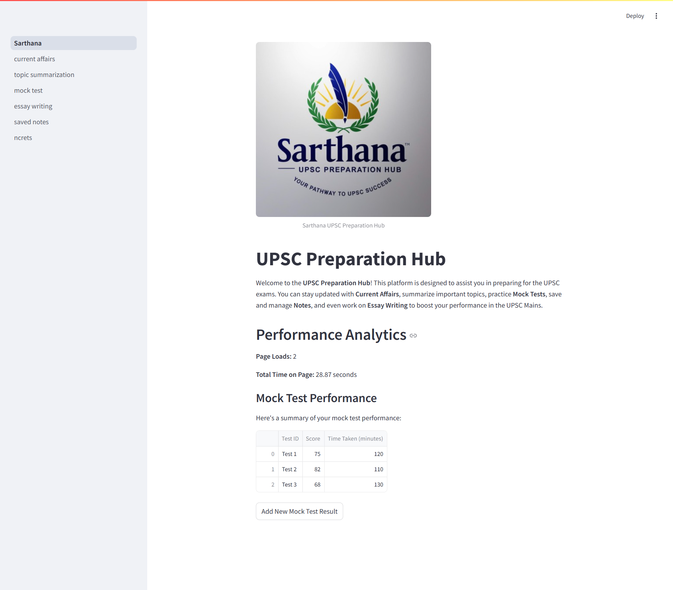
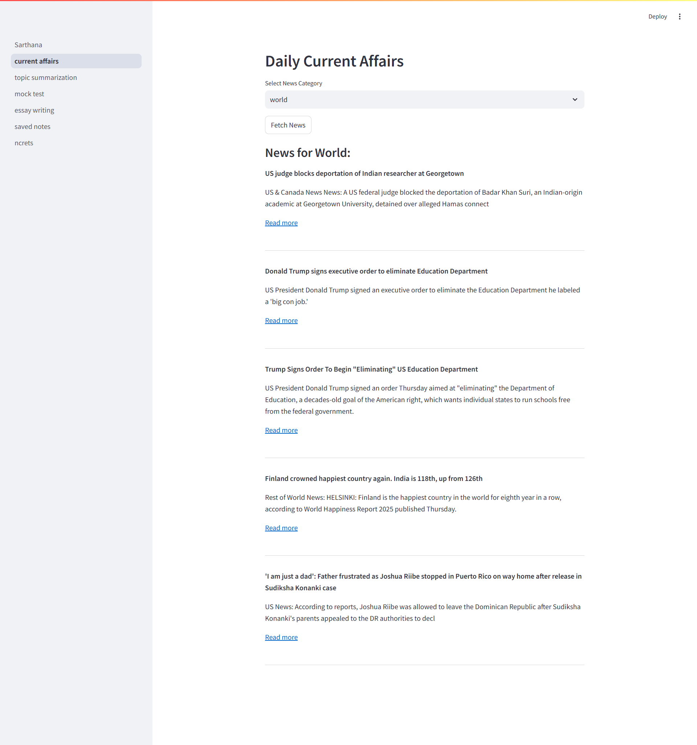
Design of Proposed Solution

Slide 11
Uniqueness/ Key Features of Innovation
AI-powered Smart Learning – Adaptive study plans based on user progress.
Multi-Language Support – Breaks language barriers in UPSC preparation.
Real-Time Mock Test Analysis – Personalized feedback for improvement.
AI-based Topic Summarization – Saves revision time.
Community-Driven Learning – Peer discussion & mentor support.

Slide 12
Technical Specifications
Component | Technology Used
Backend | PostgreSQL
Frontend | React JS
Database | supabase
AI Features | NLP-based Text Summarization, GPT-based Chatbot

Slide 13
Proof of Concept/Functionality
AI-Powered Summarization: Simplifies complex topics by generating clear and concise summaries, helping aspirants focus on essential details without spending hours reading.
Real-Time Performance Tracking: Provides instant feedback after every mock test, helping users identify strengths and weaknesses for more effective preparation.
Adaptive Learning System: Adjusts the difficulty of questions based on individual performance, ensuring a personalized and efficient learning experience.
Multilingual Support: Breaks language barriers by offering AI-driven translations, making high-quality study materials accessible to a wider audience, including rural and non-English speakers.
Smart Question Bank: Curates practice questions based on previous mistakes, reinforcing learning and improving long-term retention.
Voice Assistance & Chatbot Support: Enables quick doubt resolution with AI-driven assistants, making the learning process more interactive and engaging.
Sarthana is designed to make UPSC preparation smarter, more efficient, and tailored to each aspirant’s journey.

Slide 14
Working and functionality of the Product
Sarthana: Your Smart UPSC Companion
1. Simplified Content Access
Brings together NCERTs, standard UPSC books, and current affairs in one place.
Organizes everything neatly into Prelims, Mains, and Optional subjects for easy navigation.
2. AI-Powered Learning
Uses advanced AI to summarize lengthy topics, saving time and effort.
Supports multiple languages so that every aspirant can learn in their preferred language.
3. Smarter Quizzes & Mock Tests
Adapts to your performance, offering quizzes that challenge and improve your understanding.
Let’s you practice in both timed and relaxed modes to match real exam scenarios.
4. Personalized Dashboard
Tracks your progress with interactive visuals like graphs and heatmaps.
Allows bookmarking and note-taking so you can revisit important topics anytime.
5. Anytime, Anywhere Learning
Works seamlessly on web and mobile, so you can study from any device.
Includes an offline mode, ensuring access to study materials and previous quizzes without the internet.

Slide 15
Conclusion
Preparing for UPSC is challenging, but Sarthana is designed to make it smarter, easier, and more effective. By integrating AI-driven summarization, real-time performance tracking, and an intuitive user experience, we are not just building a tool—we are creating a personalized learning companion for aspirants.
Quick and clear topic summaries to reduce time spent searching and improve understanding.
Real-time mock test insights to help track progress and improve strategically.
A seamless, user-friendly experience that adapts to individual learning needs.
This is just the beginning. As we refine and expand Sarthana, our goal is to empower UPSC aspirants with smart, data-driven learning that helps them stay ahead in their journey. The future of UPSC preparation is here—focused, efficient, and built for success.

Slide 16
Thank You

